Slide 1
Information economy landscape: Nepal

Slide 2
Information economy landscape: Nepal
The world is changing rapidly. In the last sixty years it has seen miraculous developments. Coming out of the ashes of World War II, Western Europe has established itself as the most stable region of the world. Totally destroyed Japan, having been the victim of the only atomic bomb in human history, which killed hundreds of thousands, has established itself as the strongest economy of Asia, and second only to the United States worldwide. We have seen the rise of South Korea, which had the equal per capita income as Mozambique in late fifties. Today South Korea stands as a developed country. We have seen the growth of China when Mao went. From Deng Xiaoping to Xiang Jemin to Hu Jintao, it kept its economy open and recently overtook Germany as the third largest economy of the world. China is on the way to become the second largest economy. India, from the early ninetees, took similar policy. India grew when the world economy was in downturn. The rise of BRIC (Brazil, Russia, India and China) countries has re-shaped the world order. Mexico proudly declares itself as a North American country today and no more intends to turn back to its old identity as a Central American country. The North American Free Trade Agreement (NAFTA) has been good for Mexican economy as they can sell their products in the United States and Canada now. Indonesia shares similar story. Even though it was runned by one of the terrible dictator of the world, Suharto, he brought liberal policies in the country encouraging Privatisation, Free Trade and more market liberalization. After the Asian financial crisis of 1997, people lost faith in him and finally toppled him. Growth was felt in other parts of the world as well. Emergence of computarized technologies, World Wide Web, digital technologies etc have reshaped the world. Nepal, however, did not change much. Even though it enjoyed the modern developments from other parts of the world, it could not establish itself as a country capable to adopt such changes. There are many things to blame. Ill adviced policies of the past, weak justice system, ineffective education policies, high corruption, nepotism etc are just handful of things.

Slide 3
Information economy landscape: Nepal
Nepal is a himalayan country in south Asia located between two giants China and India. China (Tibet) borders the complete north with long himalayan ranges whereas India borders in the east, west and the south. Being a land-locked country, Nepal is strongly dependent on two neighbours. This dependency, unfortunately, allows India and China to practice political influence in the young democratic federal republic. Hence, a good relation with two neighbours, both emerging as global powers now, is vital. Nepal’s economy is dependent on tourism, even though the total number of tourist arrivals is very less in international comparison. Due to the physical geography, the distance to Europe and North America is large, which means a less number of arrivals from richer parts of the world. In the recent years, however, tourists from south Asian region have drastically increased. Nepal introduced the visa-waiver system for the citizens of former SAARC countries namely India, Pakistan, Bangladesh, Srilanka, Bhutan and Maldivs.
The second important source of income is the Remittance sent by the people working in foreign countries. Worldwide, the Inter American Development Bank (IDB) reports that around $ 300 billion has gone to the developing countries in 2006³. Nepal belongs to a part of it. Hundreds of thousands have left in the recent years for Gulf regions to work in the booming economies of the Middle East. Malaysia, UAE, Saudi Arabia, Qatar, Bahrain etc are among the largest job providers. Tens of thousands are in North Africa, Israel and in Asia pacific region. Small numbers of people have made their way to Europe and North America but most of them are students whose main aim is first of all to complete a degree, atleast for the first few years. Experiences from social network websites shows that even as a student, these young people are managing to send small amounts every month back home.

Slide 4
IT policy and strategy nepal
What Are It Policy Of Nepal?
By 2005, Nepal will be on the global map of information technology under the vision of its Information Technology Policy. In IT policy, the goal is to make IT accessible to the general public and to increase employment through IT. 3) Establish knowledge-based industries. 4) Build a knowledge-based society.
What Are The Main Policies Of It Policy 2002?
Invest in the development of information technology infrastructure in a way that encourages native and foreign investment. By utilizing information technology, you can legally and effectively promote e-commerce. Rural areas can be developed using information technology. School curriculum should include computer education.
Why Is It Policy Needed In Nepal?
By utilizing this technology, economic consolidation, democratic norms and values will be developed, economic resources will be distributed proportionally, public awareness will be enhanced, and living standards will be raised, thereby contributing significantly to poverty reduction.

Slide 5
IT policy and strategy nepal
Who Makes Policy In Nepal?
State public policies are highly concerned about this issue. It is the government’s responsibility to develop policy regarding burning public affairs either to initiate new action for change or to stop some actions, since public policy is “anything a government chooses to do or not to do” (Dye, 1972: 2).
What Are The 3 Policies?
Fiscal policy, monetary policy, and supply-side policies are the three main types of macroeconomic policies in the government.
What Are The 4 Stages Of The Policy Process?
In simplified terms, the public policy process consists of four phases: agenda setting, formulation, implementation, and evaluation.
What Is An Ict Policy?
Governments and stakeholders work together to create a National ICT Policy that aims to provide access to information to all individuals and communities through the use of digital technology.

Slide 6
IT policy and strategy nepal
Who Makes Policy In Nepal?
State public policies are highly concerned about this issue. It is the government’s responsibility to develop policy regarding burning public affairs either to initiate new action for change or to stop some actions, since public policy is “anything a government chooses to do or not to do” (Dye, 1972: 2).
What Are The 3 Policies?
Fiscal policy, monetary policy, and supply-side policies are the three main types of macroeconomic policies in the government.
What Are The 4 Stages Of The Policy Process?
In simplified terms, the public policy process consists of four phases: agenda setting, formulation, implementation, and evaluation.
What Is An Ict Policy?
Governments and stakeholders work together to create a National ICT Policy that aims to provide access to information to all individuals and communities through the use of digital technology.

Slide 7
IT policy and strategy nepal
INFORMATION TECHNOLOGY POLICY, 2057
Objectives:
The information technology policy shall be formulated to achieve the following objectives:
To make information technology accessible to the general public and increase employment through this means,
To build a knowledge-based society, and
To establish knowledge-based industries.

Slide 8
Application of ICTs in public and private sector
Communications technology system design
Training and research development
Call center/BPO, services related to communications technology
Software upgrading
Seminars and technical support
Data warehouse, data backup and recovery management services and
Hardware development

Slide 9
Level of e-business related activities,
Activity Level: Order processing, online purchasing, e-mail, content publishing, business intelligence, online advertising and public relations, online sales promotions, dynamic pricing strategies online, and social media communication.
Business Process Level: Customer relationship management, knowledge management, supply chain management, community building online, database marketing, enterprise resource planning, and mass customization
Enterprise Level: E-commerce, direct distribution, portal, social networking, online brokers, manufacturer’s agents, purchasing agents.

Slide 10
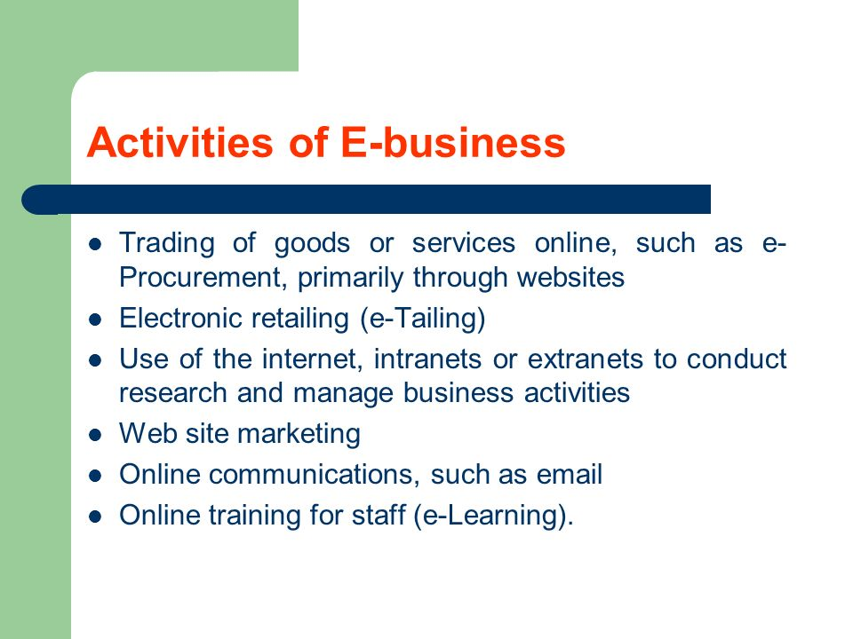
Level of e-business related activities,

Slide 11
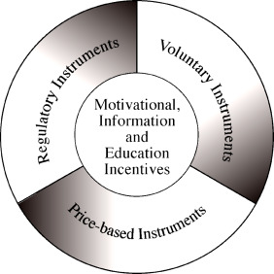
prevailing Regulatory instruments

Slide 12
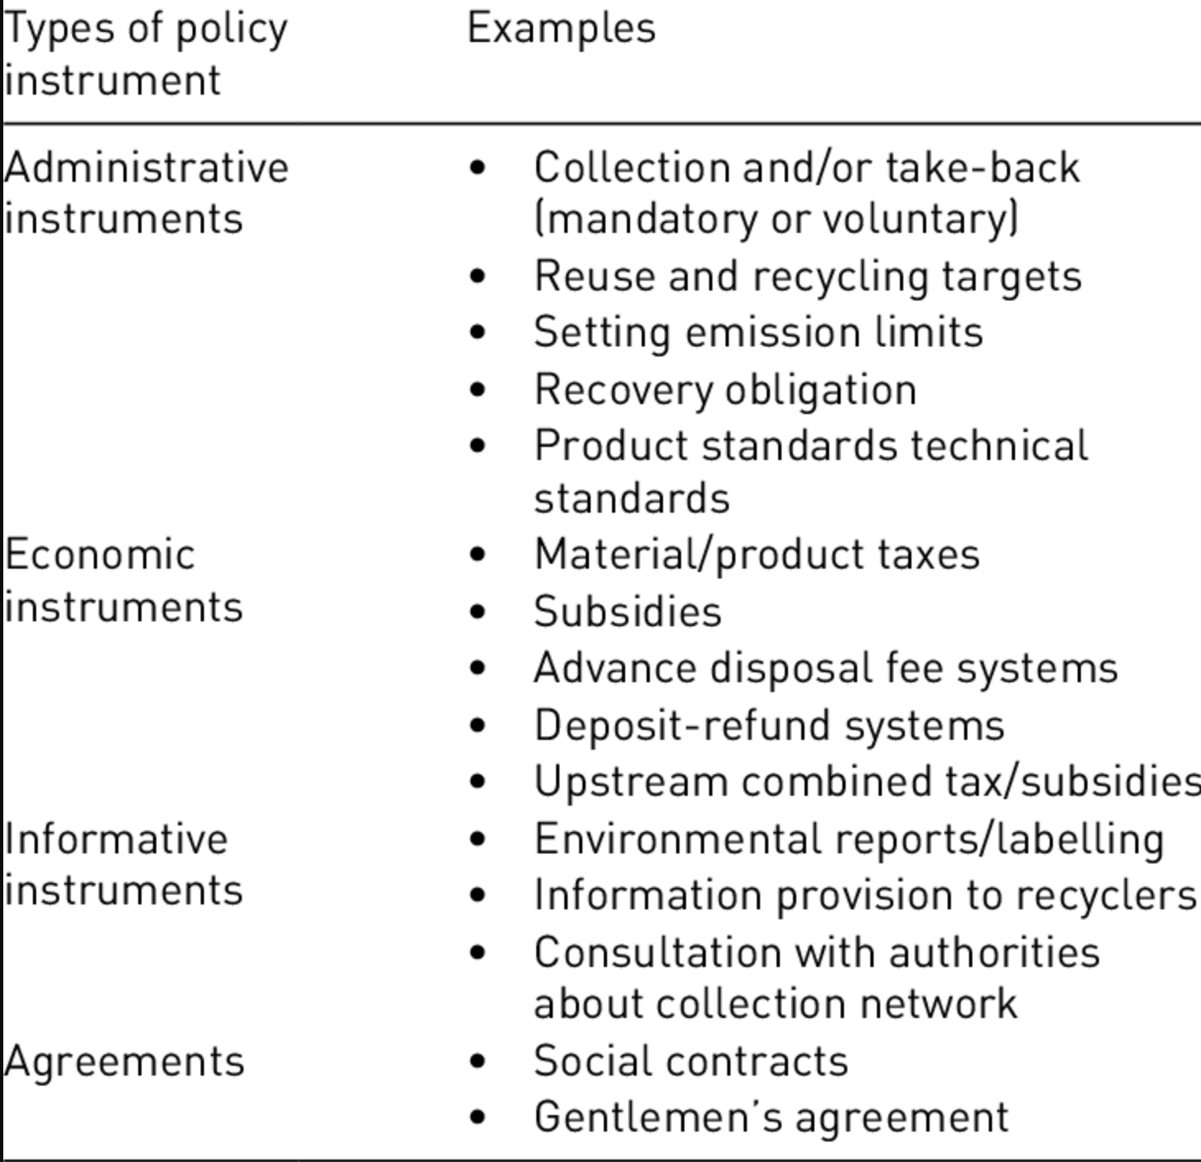
prevailing Regulatory instruments

Slide 13
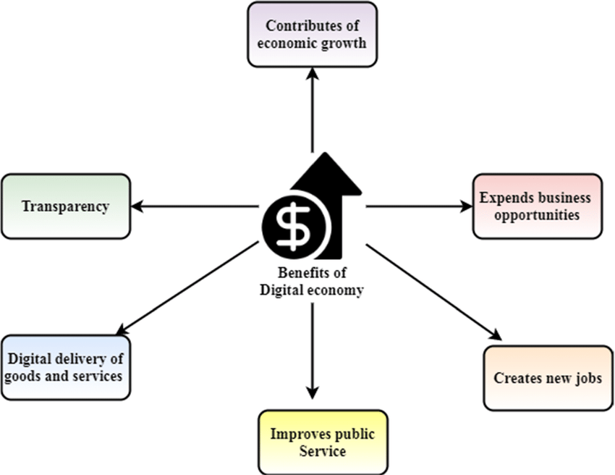
Opportunities/Constraints/ limitations

Slide 14
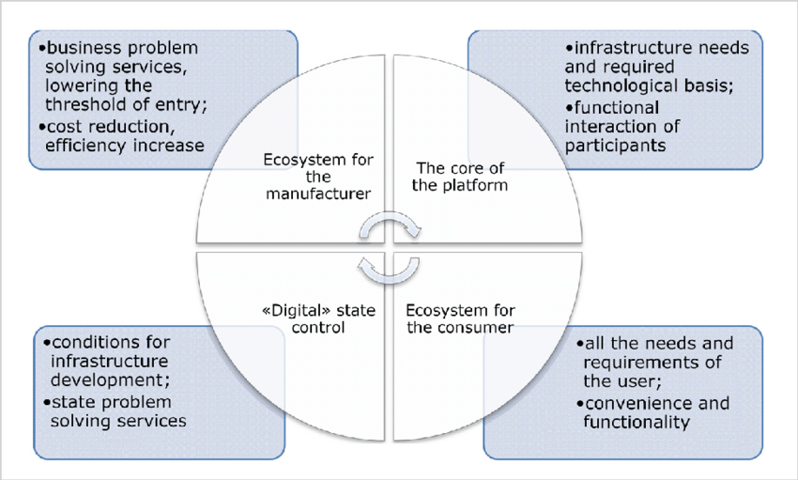
Opportunities/Constraints/ limitations

Slide 15
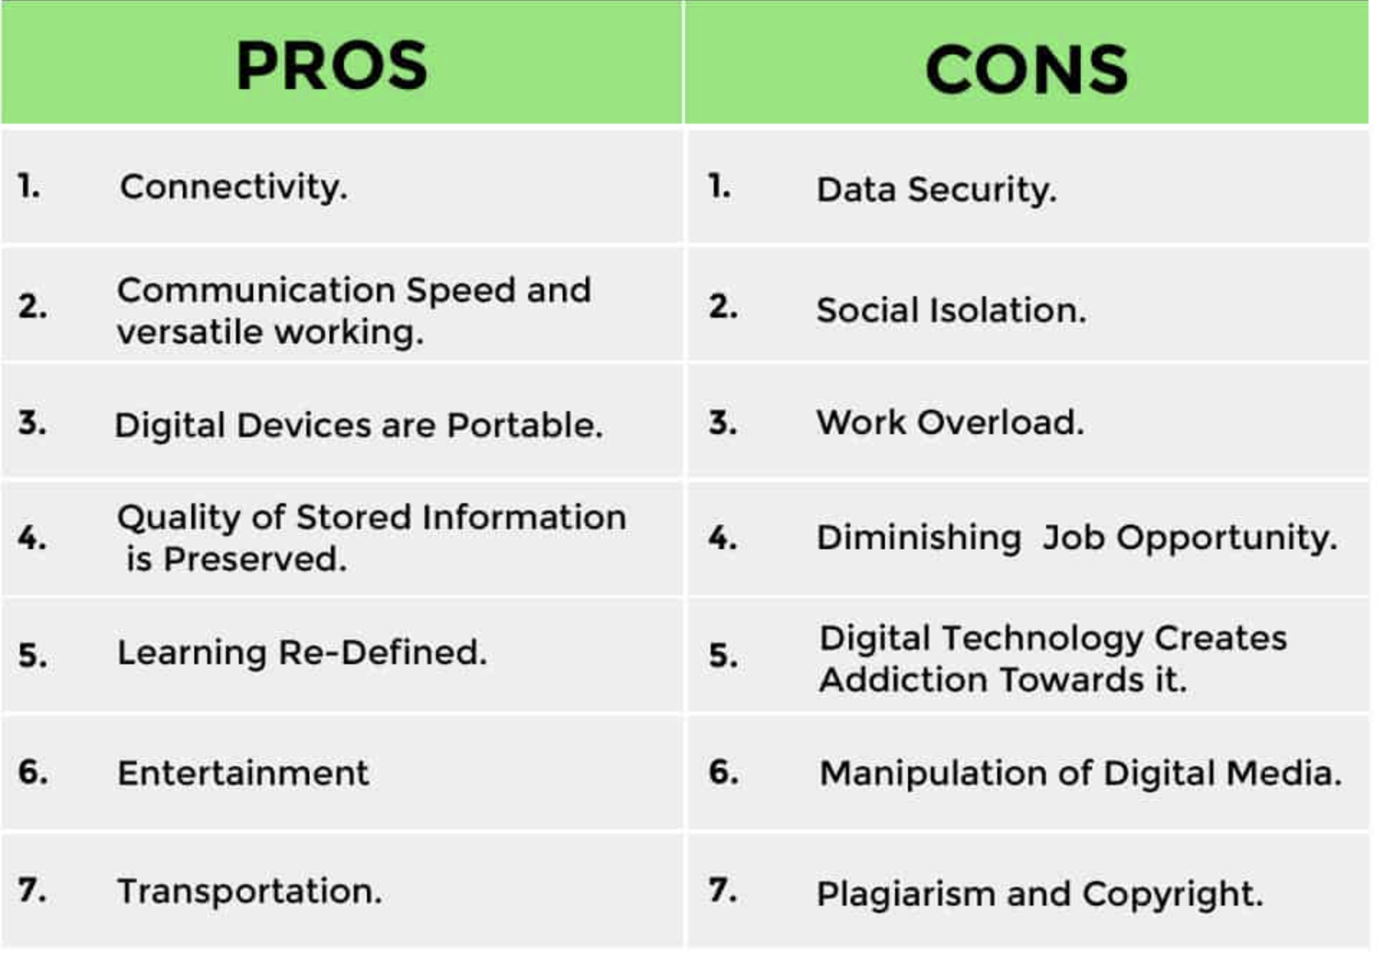
Opportunities/Constraints/ limitations

Slide 16
https://www.oclc.org/content/dam/oclc/reports/escan/downloads/economic.pdf
https://www.forestrynepal.org/what-are-the-strategies-of-it-policy-of-nepal/
http://www.asianlii.org/np/legis/laws/itp2057311/
https://loksewajob.com/information-communication-technology-ict-policy-nepal-2072-2015/
http://nbinepal.org.np/wp-content/uploads/2015/01/Private-Sector-and-Public-Security-in-Nepal-International-Alert-and-NBI-2010.pdf

